Slide 1


Biocial (Edge Based Facial Recognition)

Slide 2
TABLE OF CONTENTS
01
ABSTRACT AND PROBLEM STATEMENT
02
INTRODUCTION AND EXAMPLE
03
OUR SYSTEM
04
DEMO

Slide 3
ABSTRACT AND PROBLEM STATEMENT

Slide 4
Abstract
01
02
03
04
We are in a pursuit of automating our day-to-day process and the full potential of biometrics verification process is yet to be utilized as we haven’t completely moved to contactless biometrics verification systems.
This attempt to make use of a contactless biometrics verification system will increase our dependency on the internet.
Solution
Using this project, we are trying to achieve an edge-based biometrics computation system that would reduce the network latency and optimize the process.
And the recent corona threat has increased the need for a contactless system.

Slide 5
Problem Statement
The recent corona threat has increased the need for a contactless system and also we have to reduce a network latency and network dependency.

Slide 6
Understanding a Problem Statement:
01
02
03
04
To develop an edge based biometric system
Where the edge computation system caches a slice of appropriate data
Using a priority based heuristic algorithm
And reduce the network latency associated

Slide 7
INTRODUCTION AND EXAMPLE

Slide 8
Introduction
We are in a pursuit of automating our day-to-day process and the full potential of biometrics verification process is yet to be utilized as we haven’t completely moved to contactless biometrics verification systems.

Slide 9
Example:
Our use case:
A University is trying to install a biometric verification system
- Consider campuses (A, B and C) - Each campus has its repetitive set of students and faculties visiting regularly - Students and Faculties visiting campus A are frequent visitors for that particular campus and visit the other two campuses on an ad hoc basis - Our system caches records of frequent visitors on priority basis - Which removes the dependency on the internet to perform biometrics verification for the frequent individuals

Slide 10
OUR SOLUTION

Slide 11
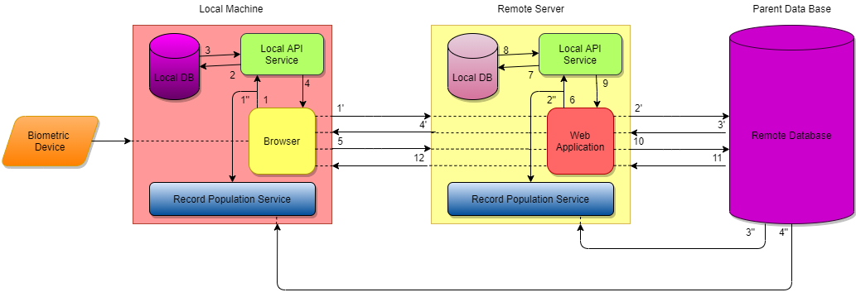
OUR SYSTEM ARCHITECTURE:

Slide 12
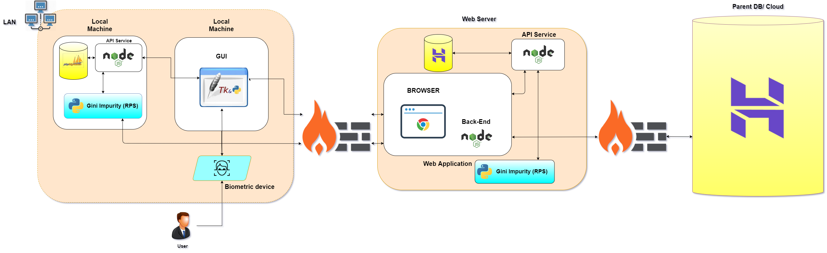
TECHINICAL ARCHITECTURE:

Slide 13
RECORD POPULATION SERVICE:
Record Population Service uses an ML algorithm and populates the local DB with the frequently accessed data.
The frequently accessed records are fetched from the collection of records from the Parent DB into the local machine
Record Population Service collects the frequent accessed data based on the frequency of the data
Record Population Service uses GINI Impurity Algorithm to categories the frequent data's.

Slide 14
ALGORITHM:
Gini Impurity:
Randomly pick a data point in our dataset, then
Randomly classify it according to the class distribution in the dataset. For our dataset, we’d classify it as blue 5/10​ of the time and as green 5/10​ of the time, since we have 5 data points of each colour.
What’s the probability we classify the data point incorrectly? The answer to that question is the Gini Impurity.

Slide 15
CALCULATION:
D1 D2 D3 D4 D5 D6 D7 F x_1 0 0 0 0 1 1 1 = 18 x_2 1 1 1 1 0 0 0 = 10 x_3 0 1 0 1 0 1 1 = 19 x_4 1 1 1 1 1 1 1 = 28 x_5 0 0 1 1 1 1 1 = 25

Slide 16
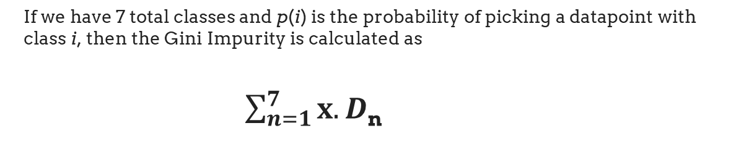
FORMULA:
If we have 7 total classes and p(i) is the probability of picking a datapoint with class i, then the Gini Impurity is calculated as
$\sum_{n=1}^{7}{x.}D$_{n}

Slide 17


COMPARISION:
Features | ZENTECH | ADONAI | BIOMATIQUES | BIOCIAL
Control over data system
Optimization in network latency
Estimation computation
Data security
Network dependency

Slide 18
DEMO

Slide 19
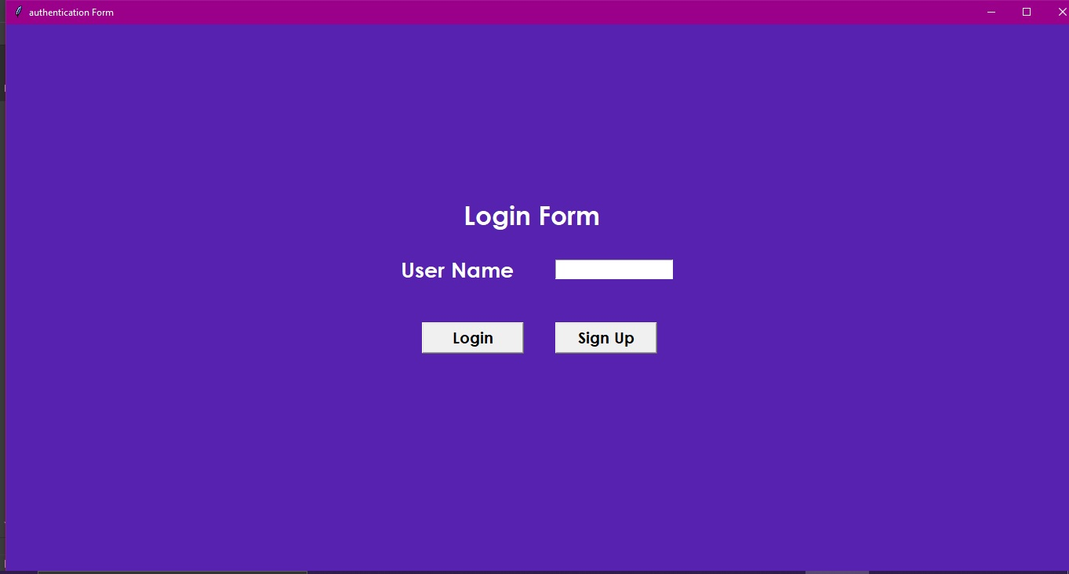
UI:

Slide 20
CASE 1
Signup: User1, User2, User3.
They login everyday.
At the end of every week the RPS is initiated to calculate the frequency for the users.
Based on their frequency level, the user data is placed at local database and at the server.
CASE 2
A new user signup.
Initially the data is stored at the local database of the machine.
Once if the RPS is initiated, the frequency will be calculated for new user along with the old user.
The remaining process is same has the CASE 1.

Slide 21
Live Demo

Slide 22
SERVER DETAILS:
HOST:
'156.67.222.175'
USER:
u651328475_facedetection
PASSWORD:
'Facedetection123'
DATABASE:
u651328475_facedetection
WEB HOSTER:
HOSTINGER

Slide 23
Use Case: Any place where biometric verification is necessary: - IT sector - College campuses - Immigration border security System Requirements: Processor : Intel Core i5-8365U Processor RAM : 8GB DDR4 2400 RAM HDD/SSD : 500GB(HDD)/120 GB (SSD) OS : Microsoft Windows

Slide 24
RESULT
The result is to come up with an edge-based biometric verification system which gives the same results as the existing system through an optimized process than that of the existing system.

Slide 25
REFERENCES:
https://us.norton.com/internetsecurity-iot-how-facial-recognition-softwareworks.
html#:~:text=A%20facial%20recognition%20system%20uses
https://www.electronicid.eu/en/blog/post/face-recognition/en
https://www.idenfy.com/facialrecognition/#:~:text=A%20facial%20recognition%
20system%20uses,helps%20to %20verify%20personal%20identity
https://machinelearningmastery.com/introduction-to-deep-learning-for-facereco gnition/
https://www.intechopen.com/books/new-approaches-to-characterization-andrec
ognition-of-faces/automatic-face-recognition-system-for-hidden-markovmodel-te
chniques
https://searchsecurity.techtarget.com/definition/biometric-verification.

Slide 26
THANKS (From Team Biocial)

Slide 27
Q&A

